Slide 1
Regression Analysis

Slide 2
Introduction to Regression
Notes:
Regression is the most fundamental technique you need to master before going to learn machine learning

Slide 3
Introduction
Let us consider two variables, years of experience and salary of software engineers working in a company
Years of experience is the independent variable and Salary is the dependent variable
In regression we try to find a relationship between the dependent variable and the independent variable i.e. between the salary and the years of experience
To do a regression, the relationship between the variables has to be linear

Slide 4
Introduction (contd.)
Consider the following table which gives the salary of software engineers with different years of experience
From this data, can we tell what is the expected salary of a software engineer with 3 years of experience?

Slide 5
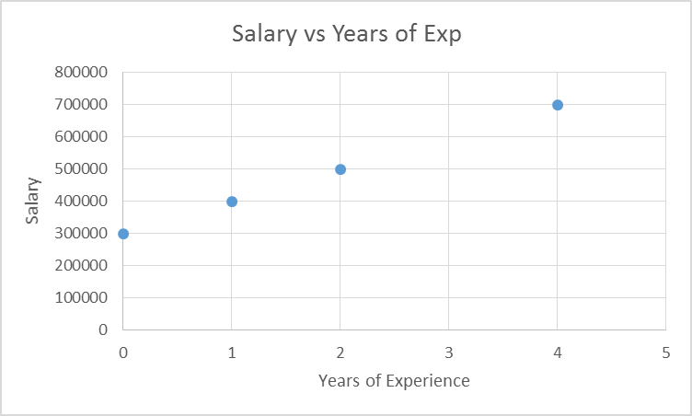
Introduction (contd.)
Let us do a scatter plot of the data
As you can see from the data, we can draw a straight line through the points

Slide 6
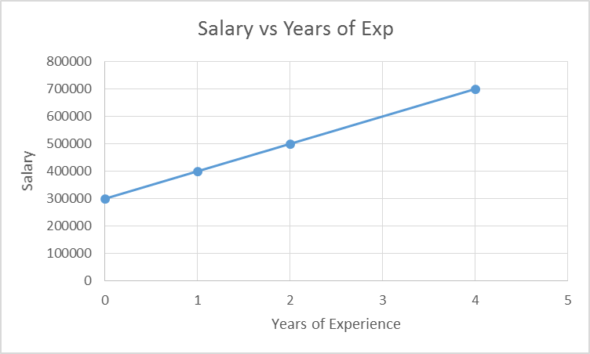
Regression Line
The line is called the regression line
The line is given by the equation:
ŷ = β₀ + β₁ (x)
β₀ is the y-intercept & β₁ is the slope of the line
β₁
β₀

Slide 7
Regression Line (contd.)
In our case, β₀ = 300000
β₁ = 100000
So the equation for our regression line is
salary = 300000 + 100000*(Years of Exp.)
Notes:
β₁ = 100000 since for every year of added experience, salary increases by 100000

Slide 8
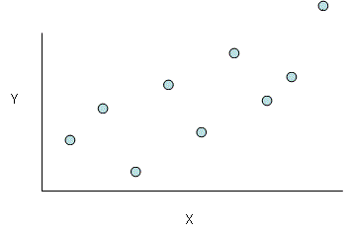
Least Squares Fit
In most practical cases, we won’t able to fit all the points in a line
For example consider the following data
The relationship between dependent and independent variables is linear
But we clearly can’t fit a straight line through all the points
Notes:
Linear relationship means as x varies, y also varies
Since we can’t fit a line with all the points, we draw a line which is closer to all the points
In other words, the distance of all the points from the line should be minimum

Slide 9
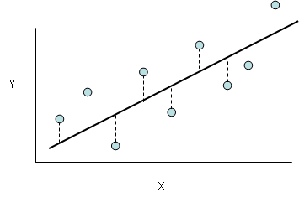
Least Squares Fit (contd.)
Least squares fit allows us to draw a line that is close to all the points
The difference between the line and the points should be minimum
Notes:
Linear relationship means as x varies, y also varies

Slide 10
Least Squares Fit (contd.)
Every point in the graph can be expressed as (x₁,y₁), (x₂,y₂), (x₃,y₃) and so on..
And for every point x₁, x₂, x₃.. we have the predicted values ŷ₁, ŷ₂, ŷ₃.. given by the regression equations ŷ₁= β₀ + β₁ (x₁), ŷ₂= β₀ + β₁ (x₂), ŷ₃= β₀ + β₁ (x₃)…
We need to reduce the square of the distance between y and ŷ
So, for our regression line,
∑y_{i} – (β₀ + β₁ (x_{i})) has to be minimum
We need to find β₀ and β₁ which minimizes the above function
Notes:
So every x has 2 y values. One is the y value and another is the y hat predicted by the model

Slide 11


Least Squares Fit (contd.)
The β₀ and β₁ which minimizes the squared error is given as follows:
Where,
Cor(Y,X) is the correlation between Y and X
Sd is the standard deviation
x̅ and y̅ are the means of X and Y respectively

Slide 12

Covariance
Covariance measures how two variables vary together
If one variable increases with increase in another variable, then covariance is positive
If one variable decreases with increase in another variable, then covariance is negative
Covariance doesn’t tell us anything about the strength of the relationship
Notes:
Covariance doesn’t tell us whether the relationship between two variables is strong or weak

Slide 13

Correlation
Correlation is another measure that explains the relationship between two variables
Correlation explains both the direction and the strength of the relationship
Correlation ranges between -1 to +1

Slide 14
Correlation (contd.)
Direction of relationship: If the value of correlation is
> 0, then the relationship is positive
< 0, then the relationship is negative
Close to 0, then no relationship
Strength of relationship: If the value of correlation is
> 0.8 or < -0.8, then the relationship is strong
Between 0.4 to 0.8 or between -0.8 to -0.4, then the relationship is of medium strength
Between -0.4 to 0.4 then the relationship is weak

Slide 15
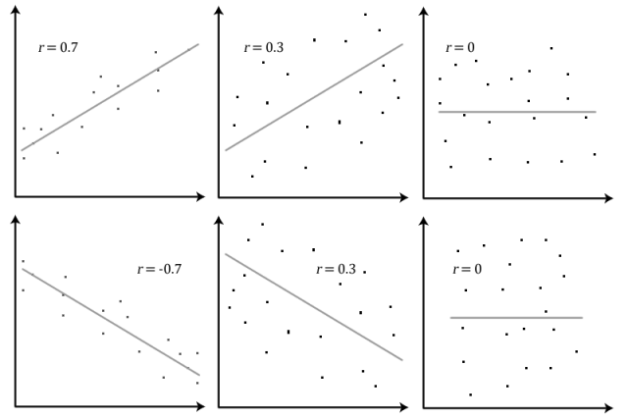
Correlation (contd.)
https://statsmethods.wordpress.com/2013/05/10/pearson-correlation-coefficient-r/
Notes:
Top two left are positively correlated. Bottom two left are negatively correlated. Left two are strongly correlated middle two are medium correlated and right two are not correlated

Slide 16
Simple Linear Regression

Slide 17
Simple Linear Regression
Involves two variables one independent variable X and one dependent variable Y
The dependent variable Y has to be a quantitative variable
We need to find a line of best fit
Y_{i} = β₀ + β₁ X_{i} + ɛ
We need to minimize the error and find and using least squares fit
Using this equation we can find the predicted Y values using the equation
ŷ_{i} = β₀ + β₁ X_{i}
Notes:
For unknown values of Y, we can use the prediction equation to find out Y values for corresponding X values

Slide 18
Assumptions of Linear Regression
The relationship between dependent and independent variables is linear
The error term should be:
Normally distributed
Independent
Homoscedastic (the error term should have the same variance across different X values)
Notes:
The normally distributed error should have mean 0

Slide 19
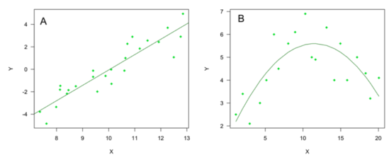
Linear and Non-Linear Relationships
http://www.edanzediting.com/content/study_planning_statistics

Slide 20

Independence of Errors
The above figures show residual errors
The errors in the first one are independent
But in the second is not independent as we can see a trend
http://www.statisticshowto.com/assumptions-conditions-for-regression/

Slide 21
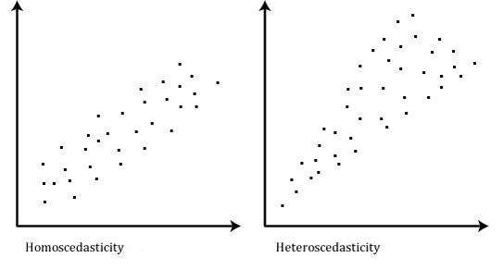
Homoscedasticity
https://statistics.laerd.com/statistical-guides/pearson-correlation-coefficient-statistical-guide-2.php
Notes:
Heteroscedasticity can be avoided using weighted regression models

Slide 22
Multiple Linear Regression
Notes:
We are going to see how to evaluate a linear model. That is to say how good your model is.

Slide 23
Multiple Linear Regression
Involves one dependent variable (Y) and more than one independent variables (X₁,X₂…X_{n})
The goal is to find the relationship between independent variables and the dependent variable
We need to find a line of best fit
Y_{i} = β₀ + β₁ X_{i1} + β₂ X_{i2} + … +β_{n} X_{in} + ɛ
We need to minimize the error and find and using least squares fit
Using this equation we can find the predicted Y values using the equation
ŷ_{i} = β₀ + β₁ X_{i1} + β₂ X_{i2} + … +β_{n} X_{in}

Slide 24
Evaluation Criteria
Notes:
We are going to see how to evaluate a linear model. That is to say how good your model is.

Slide 25
Measures
Mean Squared Error (Mean Squared Residual)
Coefficient of Determination (R²)
Adjusted R2
Mallow’s C_{p}
Notes:
These are the four measures we are going to see

Slide 26

Mean Squared Error
Mean squared error is the average of the square of errors
The model is good if the mean squared error is low

Slide 27
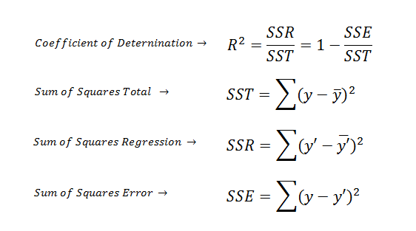
Coefficient of Determination (R²)
R² gives a measure of how much total variance in the data is explained by the model
R² takes values in the range 0 to 1
If R² is 1, then the regression line perfectly fits the data, if R² is 0, then the regression line doesn’t fit the data at all
http://www.saedsayad.com/model_evaluation_r.htm

Slide 28
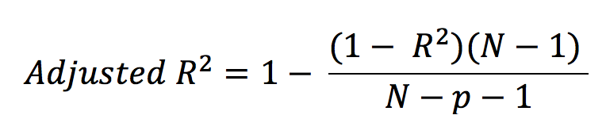
Adjusted R²
When we add more independent variables to a model, R² increases irrespective of whether the additional variables improve the model or not
Adjusted R² penalizes the model if the new variable doesn’t fit the model
Adjusted R² can take any value unlike R² which can be within the range of 0 to 1
Here p is the number of independent variables

Slide 29

Mallow’s C_{p}
Mallow’s C_{p} is used in selecting the best regression model
Mallow’s C_{p} value should to be small and close to the number of independent variables used in the model
Here N is the sample size and P is the number of independent variables used in the model
Notes:
Don’t explain the following. This is for your own understanding:
Mallows's Cp addresses the issue of overfitting, in which model selection statistics such as the residual sum of squares always get smaller as more variables are added to a model. Thus, if we aim to select the model giving the smallest residual sum of squares, the model including all variables would always be selected. The Cp statistic calculated on a sample of data estimates the mean squared prediction error (MSPE) as its population target

Slide 30
Linear Regression t-test
We can use the t-test to test whether each coefficient used in the linear model is 0
Example:
The t-test with the intercept tests the null hypothesis H₀: β₀ = 0
The t-test with the first variable tests the null hypothesis H₀: β₁ = 0 to be true

Slide 31
Linear Regression Partial F-test
Partial F-test is used to compare two linear models
Let us say there are two models on the same data
One with 3 variables var1, var2 and var3 and the other with only 2 variables var1 & var2
Partial F-test between these two models tests the null hypothesis that the coefficient of var3 is 0
i.e. β₃ = 0
This is similar to the t-test
However using partial F-test we can compare more than one variable

Slide 32
Partial F-test (contd.)
For example, let us say one model has 5 variables var1, var2, var3, var4 and var5 and the second one has only 3 variables var1, var2 and var3
Partial F-test between these two models tests the null hypothesis that both the coefficients of var4 and var5 = 0
i.e. β₄ = β₅ = 0

Slide 33
Linear Model Selection
Notes:
We are going to see how to evaluate a linear model. That is to say how good your model is.

Slide 34
Linear Model Selection
Involves the process of selecting a subset of relevant features or independent variables to be used in building a linear model
The goals is to identify a subset of independent variables or predictors that influence the dependent variable and to fit a least squares model using the subset of independent variables
If there are p independent variables, the number of possible models is 2^{p}
We are going to study three methods:
Backward Elimination
Forward Selection
Stepwise Regression
Notes:
We tried using different variables in the multiple linear regression example. Not every independent variable will have an effect on the dependent variable. Our goal is to find the subset of independent variables which influence the dependent variable most. One ways is to build all the possible models and compare which one does best. It is not possible to compare all 2 power p models especially if p is very high. If I have 10 variables, then I am looking at approximately 1000 models. But if the no of variables is 40, I am looking at 1 trillion models. Hence we need to use the stepwise selection techniques

Slide 35
Backward Elimination
In this method, we start with all the independent variables or predictors in the model
Remove the variable with highest p-value greater than the alpha value
Refit the model after removing the variable
Remove the next variable with highest p-value greater than the alpha value
Refit the model and repeat the process until all the p-values are less than alpha

Slide 36
Forward Selection
This is the reverse process of backward elimination
For all the predictors which are not in the model, check their p-value if they are added to the model
Choose the one with the lowest p-value which is lower than the alpha value
From the rest of the predictors, check the p-value if they are added to the model
Choose the one with the lowest p-value which is greater than the alpha value
Repeat the process until there are no predictors with p-value lower than alpha

Slide 37
Stepwise Regression
Combination of backward elimination and forward selection
Helps us when we have added or removed a variable early in the process and we want to remove them at a later stage
This is because the significance of one predictor might be influenced by the presence or absence of another
In stepwise regression, after a new predictor is added, all other predictors which are already in the model are checked to see if the p-value falls below alpha level
If the p-value of any of any of the predictors falls below alpha level then that predictor is removed before moving on to the next step
Notes:
There is a possibility that we might run into a loop while doing stepwise regression. So special care should be made that we don’t run in a loop

Slide 38
Multicollinearity
Notes:
We are going to see how to evaluate a linear model. That is to say how good your model is.

Slide 39
Multicollinearity
A phenomenon in which two or more predictor variables in a multiple regression model are highly correlated
Since one predictor variable is correlated with the other, it is possible to predict one with another using linear fit
Multicollinearity can be detected using:
Correlation Matrix
Variation Inflation Factor (VIF)

Slide 40
Effects of multicollinearity
Multicollinearity increases the uncertainty about the estimated coefficients and as a result the confidence intervals on the coefficients will be large
Individual p-values can be misleading because of multicollinearity. A variable can have a high p-value even though it is important

Slide 41
Correlation Matrix
Correlation Matrix offers a simple measure of multicollinearity
High correlation between two or more predictor variables indicate presence of multicollinearity
One disadvantage of using correlation to determine mutlicollinearity is that correlation is bivariate i.e. it measures correlation between two variables and it isn’t particularly useful when one variable is a linear combination of many variables put together

Slide 42

Variation Inflation Factor
Assesses how much the variance of an estimated regression coefficient increases if your predictors are correlated
If none of the predictor variables are correlated, then VIF will be 1
We say multicollinearity is present if the VIF of any variable is ≥ 5
Where R_{i}² is the coefficient of determination of the linear regression where dependent variable is the ith predictor variable and the independent variables are the rest of the predictor variables

Slide 43
Dealing with multicollinearity
Collect additional data
Additional data might break multicollinearity
Remove predictor variables from the model
see if VIF of any of the predictor variable is > 5
If yes, then remove the predictor variable with the highest VIF from the model
Re-compute VIF values
Repeat the steps until VIF of all the predictor variables is below 5

Slide 44
Handling Outliers
Notes:
We are going to see how to evaluate a linear model. That is to say how good your model is.

Slide 45
Leverage points & Influential observations
Leverage points are those observations, which have extreme or outlying values of independent variable but graphically they lie close to the pattern described by other points
Influential points also have extreme or outlying values of independent variable but they are far from the pattern described by other points
Leverage points don’t have much effect on the regression coefficients but Influential points have great influence on them
Influential points in a regression can be detected using Cook’s distance or Cook’s D statistic

Slide 46
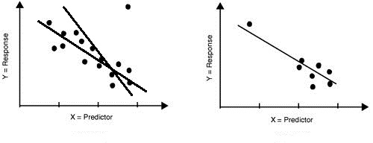
Leverage points & Influential observations (contd.)
Examples of influential observation and leverage point
There are two regression lines on the left. One is a fit obtained by including the influential observation in the regression and another without including the influential observation
Leverage Point
Influential Observation
http://www.bexcellence.org/Regression.html

Slide 47

Cook’s distance
Cook’s distance is used estimate the influence of a data point in linear regression
Cook’s distance for the ith observation is:
Where,
is the prediction from the full regression model for observation j
is the prediction for observation j from a refitted regression model in which observation i has been omitted
p is the number of fitted parameters in the model
MSE is the mean square error of the model

Slide 48
Cook’s distance (contd.)
The generally accepted cut-off values for spotting highly influential points is D_{i} > 4/(n-k-1) where n is the number of observations, k is the number of independent variables
Can we remove observations with D_{i} > 4/(n-k-1) from our regression model?
We can remove them if we have enough evidence that the influential observation was due to measurement error or other errors
If they are genuine observations, we need to include them in our model even though they are influential

